Slide 1
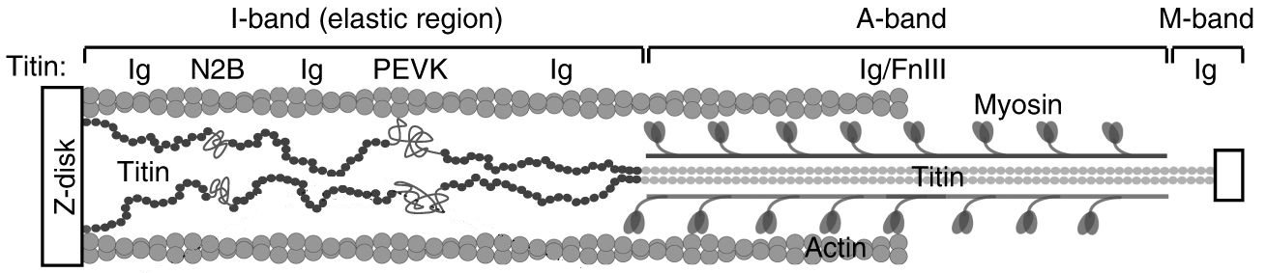
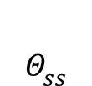
Fig 1
A
A) Image from https://www.nature.com/articles/s41467-017-02528-7 under CC by 4 international licence https://creativecommons.org/licenses/by/4.0/
\sigma_p
Legend sigma_p(0, s)…
For relaxed. pCa4.4 have a whole different story
Generated from RunCOmbinedModel
$$Θ_{ss}$$
B
actin
Z disk
Ca²⁺-dependent association
folded states
unfolded state
proximal domain
PEVK segment
distal domain
L_{p}
L_{d}
C
D

Slide 2
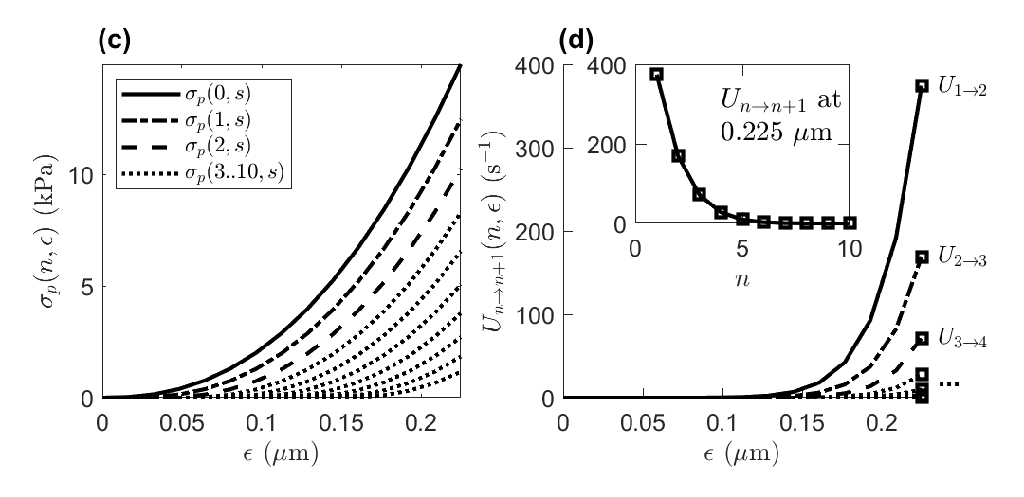
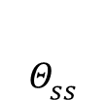
Fig 1
(a)
A) Image from https://www.nature.com/articles/s41467-017-02528-7 under CC by 4 international licence https://creativecommons.org/licenses/by/4.0/
\sigma_p
Legend sigma_p(0, s)…
For relaxed. pCa4.4 have a whole different story
Generated from RunCOmbinedModel
$$Θ_{ss}$$
(b)
actin
Z disk
Ca²⁺-dependent association
folded states
unfolded state
proximal domain
PEVK
distal domain
L_{p}
L_{d}

Slide 3
Fig2
Generated from AverageData

Slide 4
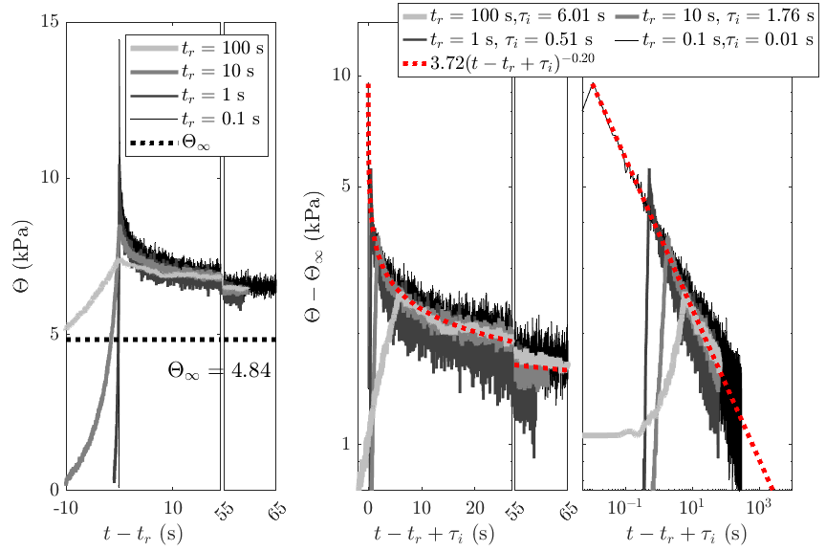
Fig3
Generated from FigFitDecayOverlay

Slide 5
Fig4

Slide 6
Fig5

Slide 7
Fig6

Slide 8
Fig7

Slide 9
Fig8 (replaces the peaks)

Slide 10
Fig9 - new

Slide 11
Fig 10 (merge previous 9 and 10?) relaxed

Slide 12
Fig 11. Refolding prediction (mod15 = 2), no Ca

Slide 13
A1- PEVK knockout

Slide 14
Parameter selection – how to explain? Selecting parameter subset and attempting to fit low calcium (6.2) based on high calcium (4.4). If successful, repeat with one removed parameter. If not successful (cost over 0.4), go back and remove a different parameter instead. Then sort by lowest paramer number and lowest cost.
Combination 1: ModSel = [4 8 9 ], NumElements = 3, Cost = 0.719
Combination 2: ModSel = [4 7 9 ], NumElements = 3, Cost = 0.721
Combination 3: ModSel = [6 7 9 ], NumElements = 3, Cost = 1.461
Combination 4: ModSel = [3 5 9 ], NumElements = 3, Cost = 1.970
Combination 5: ModSel = [3 7 9 ], NumElements = 3, Cost = 2.005
Combination 6: ModSel = [3 8 9 ], NumElements = 3, Cost = 2.082
Combination 7: ModSel = [3 4 7 ], NumElements = 3, Cost = 2.698
Combination 8: ModSel = [3 5 8 ], NumElements = 3, Cost = 3.262
Combination 9: ModSel = [3 5 7 ], NumElements = 3, Cost = 3.315
Combination 10: ModSel = [4 6 9 ], NumElements = 3, Cost = 9.986
Combination 11: ModSel = [3 4 9 ], NumElements = 3, Cost = 10.016
Combination 12: ModSel = [4 6 7 ], NumElements = 3, Cost = 10.452
Combination 13: ModSel = [3 4 8 ], NumElements = 3, Cost = 11.625
Combination 14: ModSel = [5 8 9 ], NumElements = 3, Cost = 17.875
Combination 15: ModSel = [5 7 9 ], NumElements = 3, Cost = 22.336
Combination 16: ModSel = [4 6 7 9 ], NumElements = 4, Cost = 0.329
Combination 17: ModSel = [3 4 8 9 ], NumElements = 4, Cost = 0.361
Combination 18: ModSel = [3 4 7 9 ], NumElements = 4, Cost = 0.371
Combination 19: ModSel = [3 5 7 9 ], NumElements = 4, Cost = 0.391
Combination 20: ModSel = [3 5 8 9 ], NumElements = 4, Cost = 0.394
Combination 21: ModSel = [4 5 7 9 ], NumElements = 4, Cost = 0.403
Combination 22: ModSel = [4 5 8 9 ], NumElements = 4, Cost = 0.438
Combination 23: ModSel = [3 6 7 9 ], NumElements = 4, Cost = 0.548
Combination 24: ModSel = [3 6 8 9 ], NumElements = 4, Cost = 0.621
Combination 25: ModSel = [4 7 8 9 ], NumElements = 4, Cost = 0.669
Combination 26: ModSel = [3 4 5 9 ], NumElements = 4, Cost = 0.857
Combination 27: ModSel = [6 7 8 9 ], NumElements = 4, Cost = 1.445
Combination 28: ModSel = [3 4 6 8 ], NumElements = 4, Cost = 1.452
Combination 29: ModSel = [5 6 7 9 ], NumElements = 4, Cost = 1.903
Combination 30: ModSel = [3 7 8 9 ], NumElements = 4, Cost = 2.053
Combination 31: ModSel = [3 4 6 7 ], NumElements = 4, Cost = 2.136
Combination 32: ModSel = [4 5 6 9 ], NumElements = 4, Cost = 2.193
Combination 33: ModSel = [5 7 8 9 ], NumElements = 4, Cost = 2.520
Combination 34: ModSel = [3 4 5 7 ], NumElements = 4, Cost = 2.642
Combination 35: ModSel = [3 4 7 8 ], NumElements = 4, Cost = 2.656
Combination 36: ModSel = [3 5 7 8 ], NumElements = 4, Cost = 3.263
Combination 37: ModSel = [3 4 6 9 ], NumElements = 4, Cost = 10.047
…
Combination 71: ModSel = [3 4 5 6 7 8 9 ], NumElements = 7, Cost = 0.364

Slide 15
Fig9 - new

Slide 16
Fig7

Slide 17
Fig8 (replaces the peaks)

